Slide 1
St. Michael’s CE High School
A Church of England Academy
Advent 1
wb: 1.12.25
This year – different tutorial reflections and prayers for Advent.
We’re going to try using an Advent Calendar produced by the Diocese of Guildford.
Their theme for Advent = The Joy at the birth of Jesus, which is shared by Christians across the world.
This online Calendar explores how Christians around the world tell this universal story in words and images, which ties in with our Worship Theme for 2025-26 of ‘Love your Neighbour.’
Each session has a beautifully sensitive and joyfully cultural video retelling the Nativity, an image from the same part of the world, so you might wish to choose to focus on either or use both.
There are also some questions to consider that relate to the theme, picture and video.
Hope you enjoy doing something different, Feliz Navidad!

Slide 2
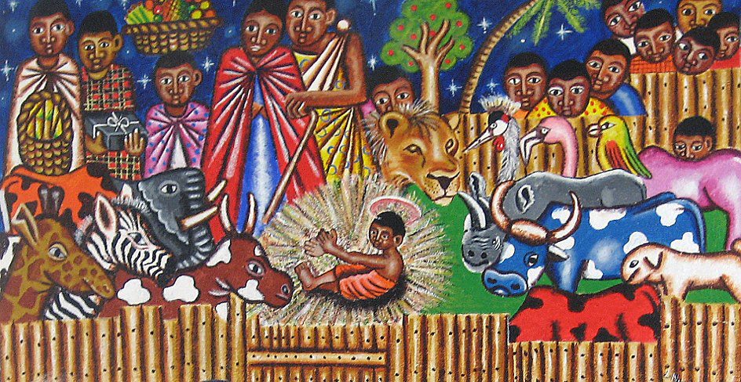
St. Michael’s CE High School
A Church of England Academy
Advent 1
wb: 1.12.25
Watch the video of Masaka Kids Africana Dancing Christmas Time
https://youtu.be/HctyEziLn5c?si=LY9JHMwMwpQIompK
Day 1
Joy to the World!
When the angels visited the shepherds to tell them that Jesus had been born they said ‘Don’t be afraid, because I am bringing you some good news. It will be a joy to all the people.' Luke 2:10
Look carefully at the picture (Next slide)
• How similar is this version of the Nativity to other images you have seen?
• What surprises you – or which sections do you have questions about?
• What would you want to ask the artist who created this piece of art?
As you watch the video together, how do these Ugandan children express their joy at the good news of the birth of Jesus?

Slide 3
St. Michael’s CE High School
A Church of England Academy
Advent 1
wb: 1.12.25
Day 1

Slide 4
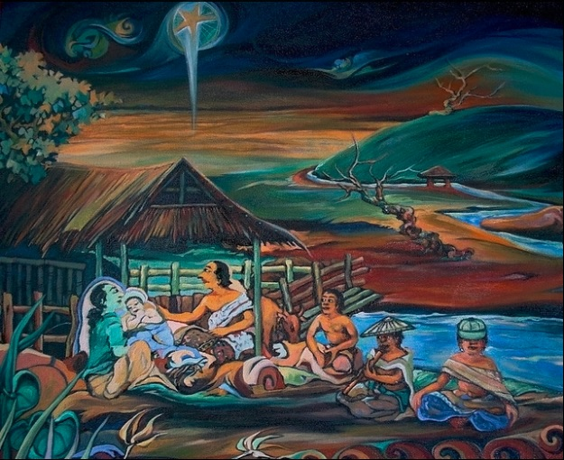
St. Michael’s CE High School
A Church of England Academy
Advent 1
wb: 1.12.25
Watch the Compassion Indonesian Nativity
https://youtu.be/jJdhAsaDnbc?si=ixhekGMW8E2-p1Dn
Day 2
Watch the video together, retold by children in Nias, Indonesia
How well do you think this cultural retelling captures the joy of the Christmas story?
How does this retelling demonstrate Christian belief in ‘Immanuel – God with us’?
What’s the same in the Biblical narrative, and what’s different – and why?
Do you think the differences matter?
Now look at the image – What connections can you find with the video?

Slide 5
St. Michael’s CE High School
A Church of England Academy
Advent 1
wb: 1.12.25
Day 2

Slide 6
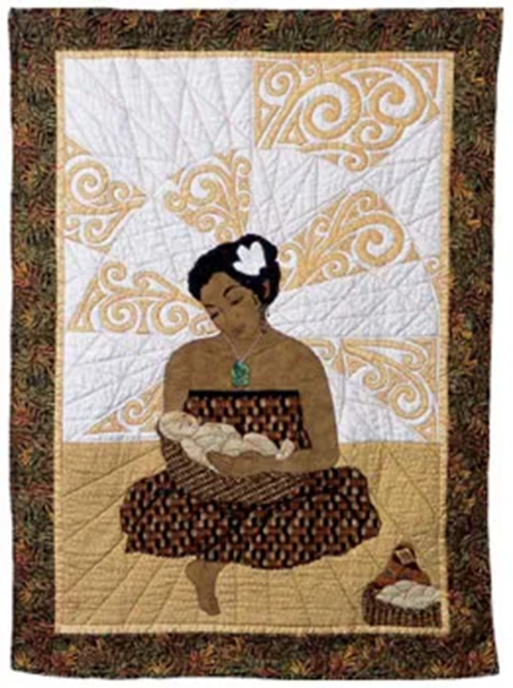
St. Michael’s CE High School
A Church of England Academy
Advent 1
wb: 1.12.25
Day 3
Watch the Nativity as told by young people in New Zealand
https://www.youtube.com/watch?v=kBaTUwhq0-4
New Zealand
Look at the image on the next slide, showing Mary wearing a traditional Māori necklace called a heitiki.
What surprises you about this image of Mary and Jesus?
What else can you see in this image that might connect with Māori traditions?
How does this image demonstrate Christian belief in ‘Immanuel – God with us’?

Slide 7

St. Michael’s CE High School
A Church of England Academy
Advent 1
wb: 1.12.25
Day 3

