Slide 1
St. Michael’s CE High School
A Church of England Academy
Advent 2
wb: 8.12.25
This year – different tutorial reflections and prayers for Advent.
We’re going to try using an Advent Calendar produced by the Diocese of Guildford.
Their theme for Advent = The Joy at the birth of Jesus, which is shared by Christians across the world.
This online Calendar explores how Christians around the world tell this universal story in words and images, which ties in with our Worship Theme for 2025-26 of ‘Love your Neighbour.’
Each session has a beautifully sensitive and joyfully cultural video retelling the Nativity, an image from the same part of the world, so you might wish to choose to focus on either or use both.
There are also some questions to consider that relate to the theme, picture and video.
Hope you enjoy doing something different, Feliz Navidad!

Slide 2
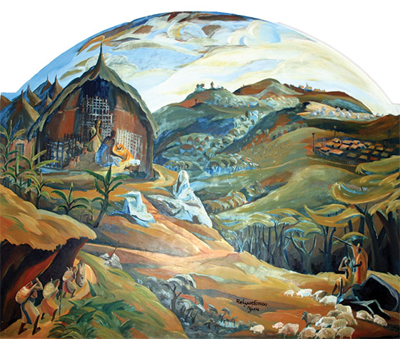
St. Michael’s CE High School
A Church of England Academy
Advent 2
wb: 8.12.25
Watch the video of the Kenyan Nativity
https://youtu.be/KX_5dPONEWw?si=qB9mXnf0kJWAcVy1
Day 4
Joy to the World!
Watch the video together, retold by children in Kenya.
How well you think this cultural retelling captures the joy of the Christmas story?
How does this retelling demonstrate Christian belief in ‘Immanuel – God with us’?
What’s the same in the Biblical narrative, and what’s different – and why?
Do you think the differences matter?
Now look at the picture (Next Slide)
What connections can you find with the video?

Slide 3
St. Michael’s CE High School
A Church of England Academy
Advent 2
wb: 8.12.25
Day 4

Slide 4
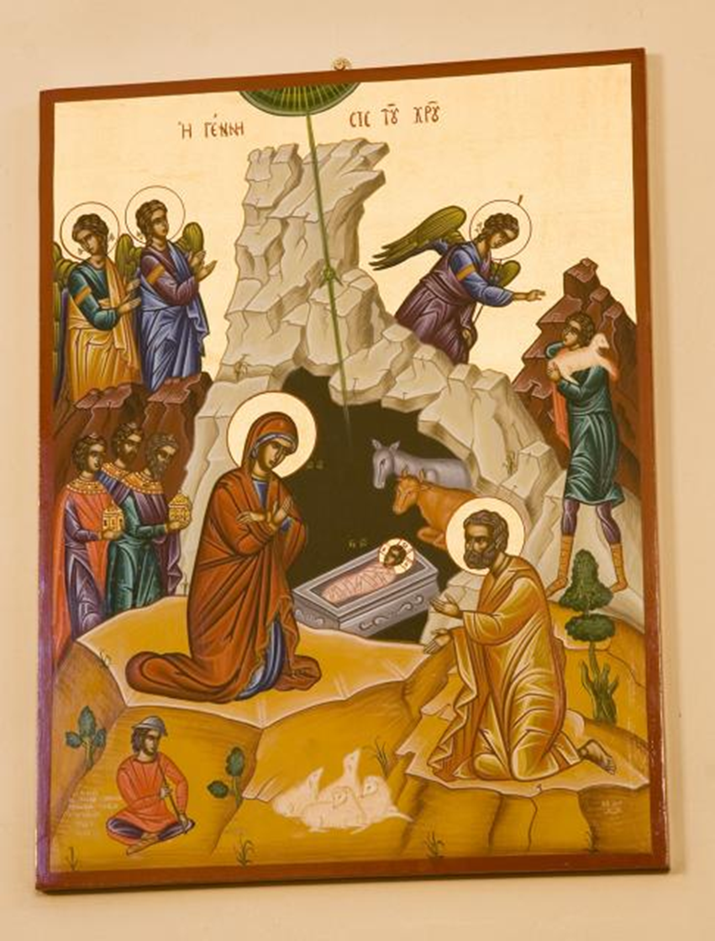
St. Michael’s CE High School
A Church of England Academy
Advent 2
wb: 8.12.25
Watch the Dai Wooldridge video: https://www.youtube.com/watch?v=pBCiRzQGNCw
Day 5
This video is from Welsh poet, and Christian, Dai Woolridge.
How does this retelling differ from those you have viewed so far?
Who do Dai and his friend represent in the Nativity account?
What has he changed to create this retelling of the story?
How does this communicate Christian belief in 'Immanuel - God with us’?
What do you think about this retelling?
Now look at the image (Next Slide), created by Welsh artist Martin Crampin, as an icon for St. Nicholas' Greek Orthodox Church in Cardiff.
How does this modern icon honour the traditions of the past?

Slide 5

St. Michael’s CE High School
A Church of England Academy
Advent 2
wb: 8.12.25
Day 5

Slide 6
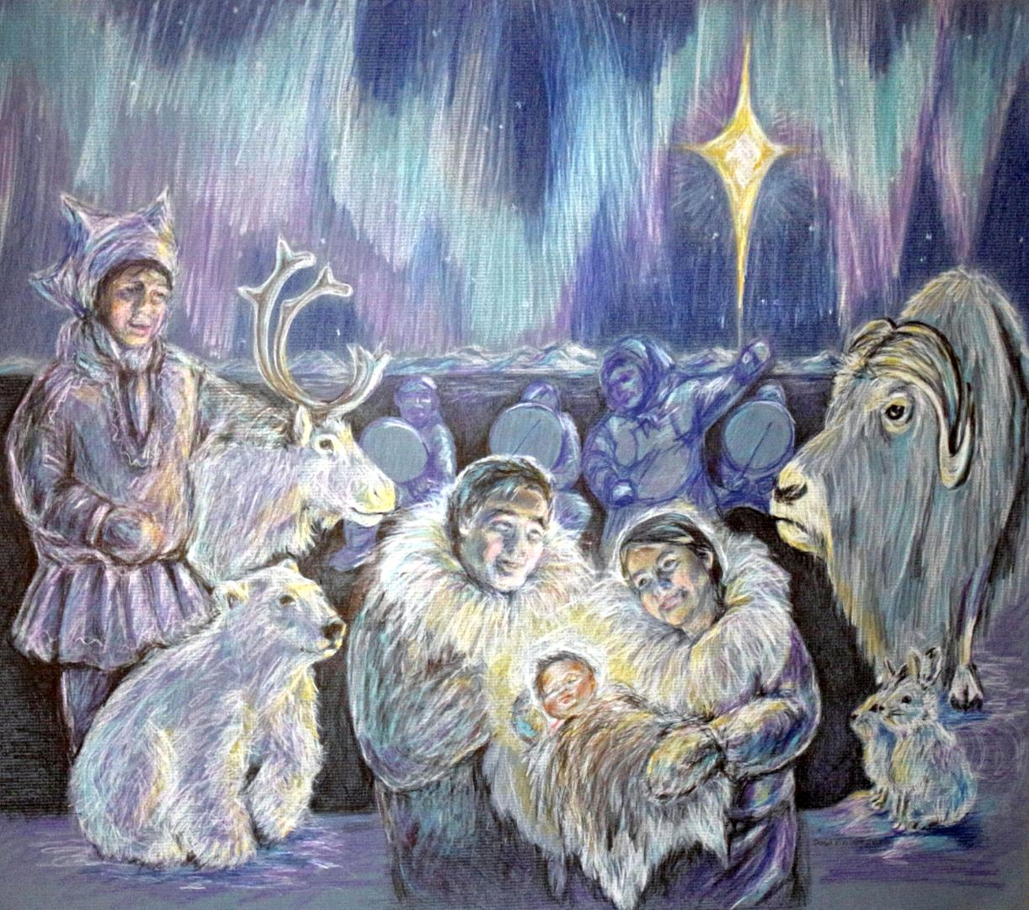
St. Michael’s CE High School
A Church of England Academy
Advent 2
wb: 8.12.25
Day 6
Watch the Christmas around the world 2024video https://youtu.be/HFe6RrCaMzs?si=QhL3jGt3HK2ZFB5m
Look at the image (Next Slide) first.
What do you find surprising in this image, created by artist Susan Ringstad Emery, who is an enrolled tribal member of Native Village of Shishmaref (Alaska)?
How does this also connect with Christians' beliefs about 'Immanuel - God with us’?
How might you show this in your own cultural context?
Today's video shows festive traditions from across the globe.
Which of these festive traditions would you like to take part in?
What special traditions do you have in your own school?

Slide 7
St. Michael’s CE High School
A Church of England Academy
Advent 2
wb: 8.12.25
Day 6

