Slide 1
St. Michael’s CE High School
A Church of England Academy
Advent 3
wb: 15.12.25
This year – different tutorial reflections and prayers for Advent.
We’re going to try using an Advent Calendar produced by the Diocese of Guildford.
Their theme for Advent = The Joy at the birth of Jesus, which is shared by Christians across the world.
This online Calendar explores how Christians around the world tell this universal story in words and images, which ties in with our Worship Theme for 2025-26 of ‘Love your Neighbour.’
Each session has a beautifully sensitive and joyfully cultural video retelling the Nativity, an image from the same part of the world, so you might wish to choose to focus on either or use both.
There are also some questions to consider that relate to the theme, picture and video.
Hope you enjoy doing something different, Feliz Navidad!

Slide 2
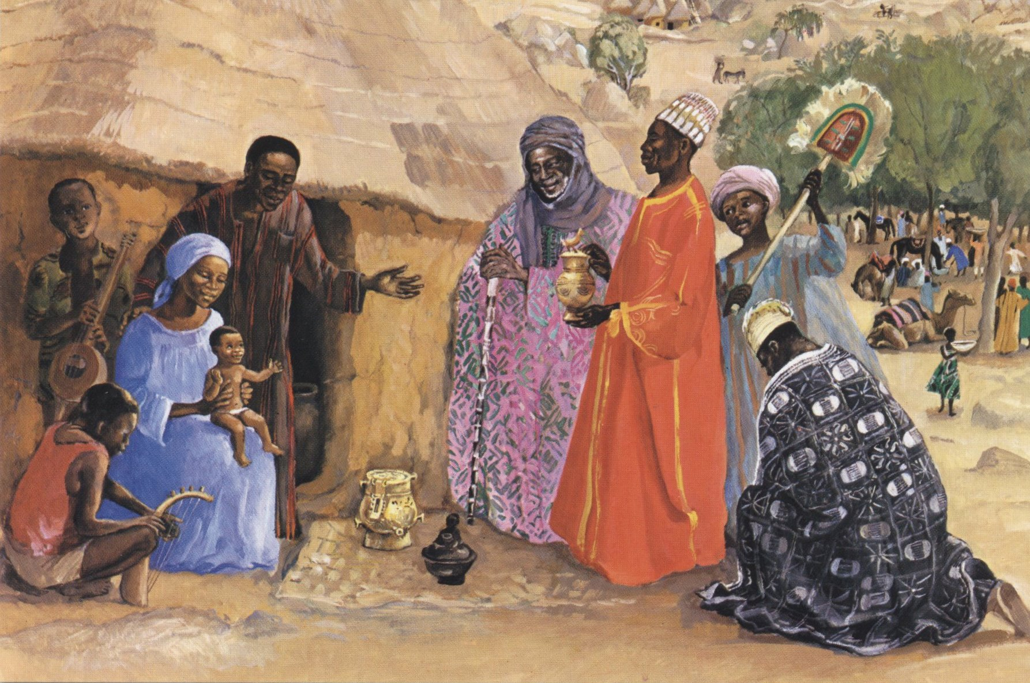
St. Michael’s CE High School
A Church of England Academy
Advent 3
wb: 15.12.25
Watch the video of Masaka Kids Africana Dancing Feliz Navidad https://youtu.be/c7swkiMsCwc?si=D84px0_1qpkmSUQu
Day 7
Cameroon and Uganda
As you watch this video together, which words in this joyful song really stand out for you?
Thinking about all the images we have seen and the words we have heard since 1st December, Which do you think have best expressed ‘Joy to the World’?
Have they helped you to understand a bit more why this story is so special to people all across the globe?
What messages of joy you think the world needs this Christmas time?
The picture (next slide) is part of a series commissioned by the Mafa people, viewed by the artist as if the events had taken place in a village in Cameroon.
How does this show their beliefs about the incarnation of Jesus as ‘Immanuel - God with us'?

Slide 3
St. Michael’s CE High School
A Church of England Academy
Advent 3
wb: 15.12.25
Day 7

Slide 4
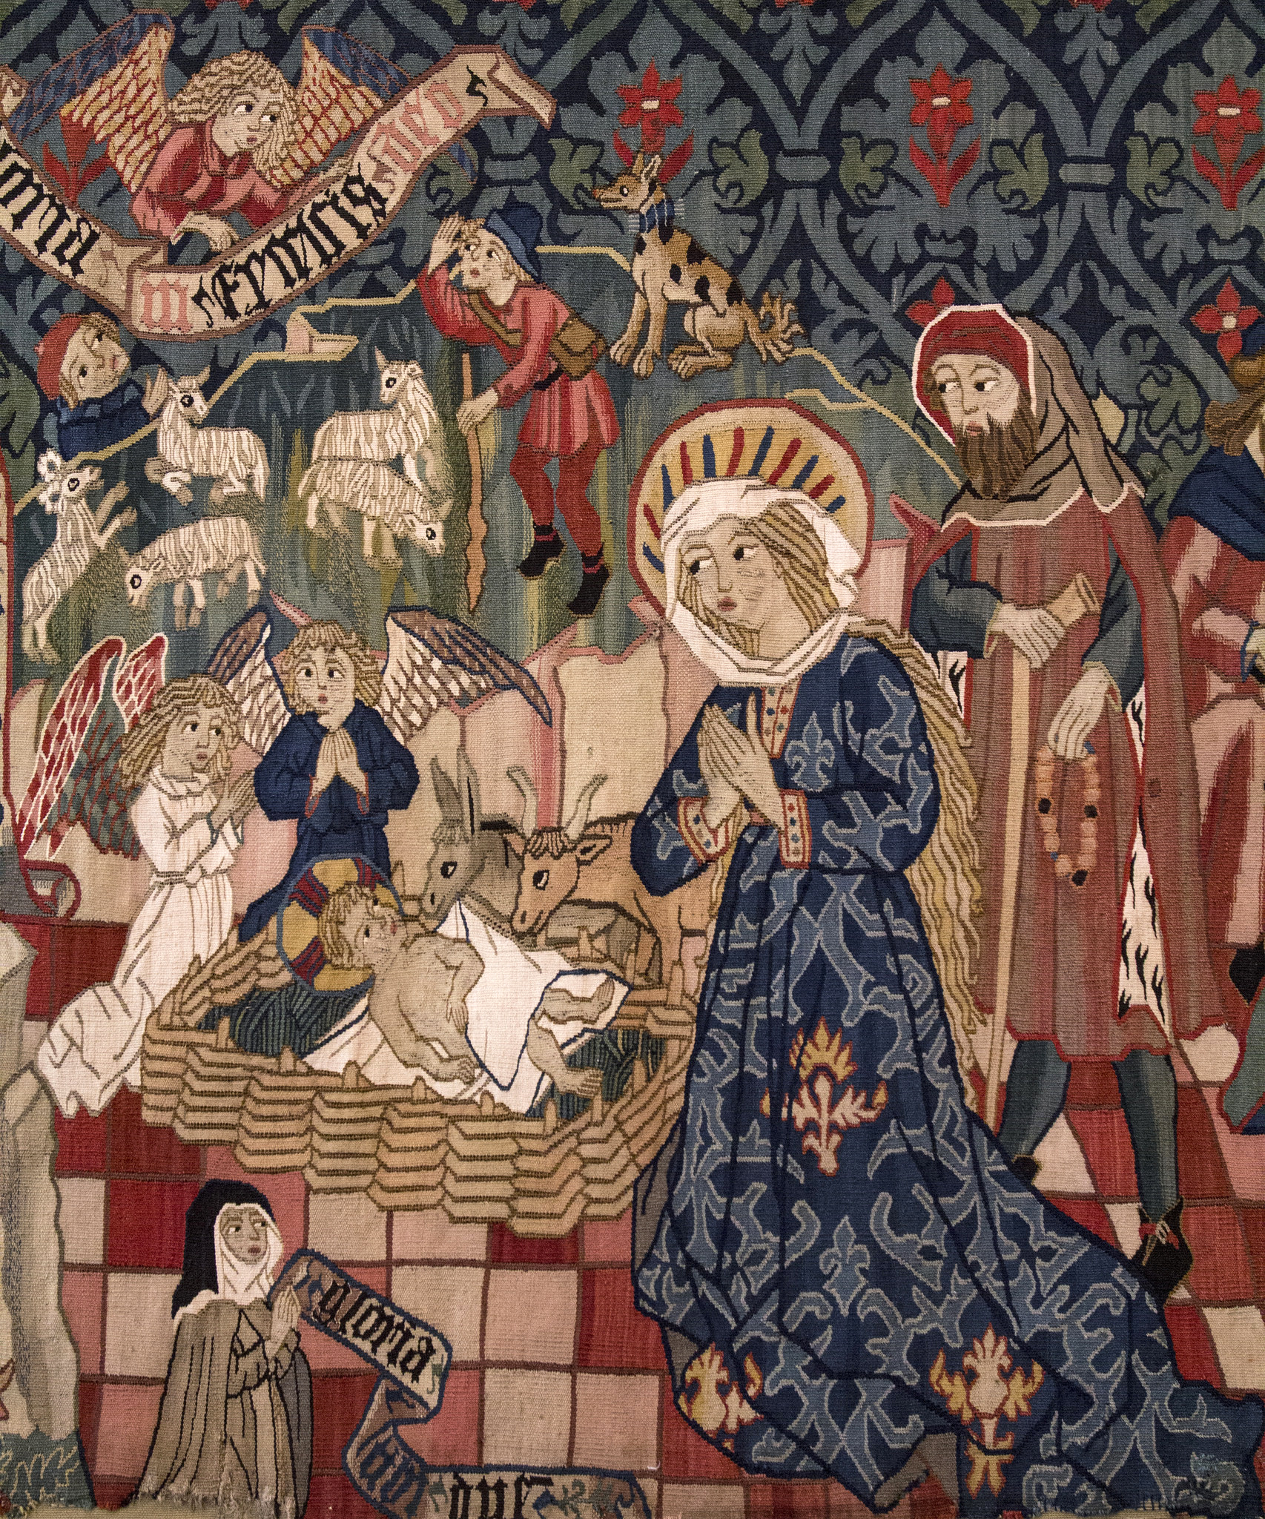
St. Michael’s CE High School
A Church of England Academy
Advent 3
wb: 15.12.25
Watch the video by All Saints, Peckham (London): https://youtu.be/f66OIrelhrc?si=gBuX0_89zhJWyfMp
Day 8
Nativity on the Overground
This Nativity was filmed at London overground stations from Clapham to Peckham Rye.
Why did the creators of this video chose to recreate the Nativity account in this way?
How are the words in different languages significant?
How do you think this version of the Nativity impacted people on the platforms?
What might a Nativity ’flashmob’ like this look like in your neighbourhood?!
Now look at the picture (next slide) carefully. This is the oldest piece of art in our calendar, dating from c.1480 and is part of a much larger tapestry, showing 4 scenes from the Nativity account.
Why has it been so important to artists across the ages, and across the world, to show the Nativity in so many different ways?

Slide 5
St. Michael’s CE High School
A Church of England Academy
Advent 3
wb: 15.12.25
Day 8

Slide 6
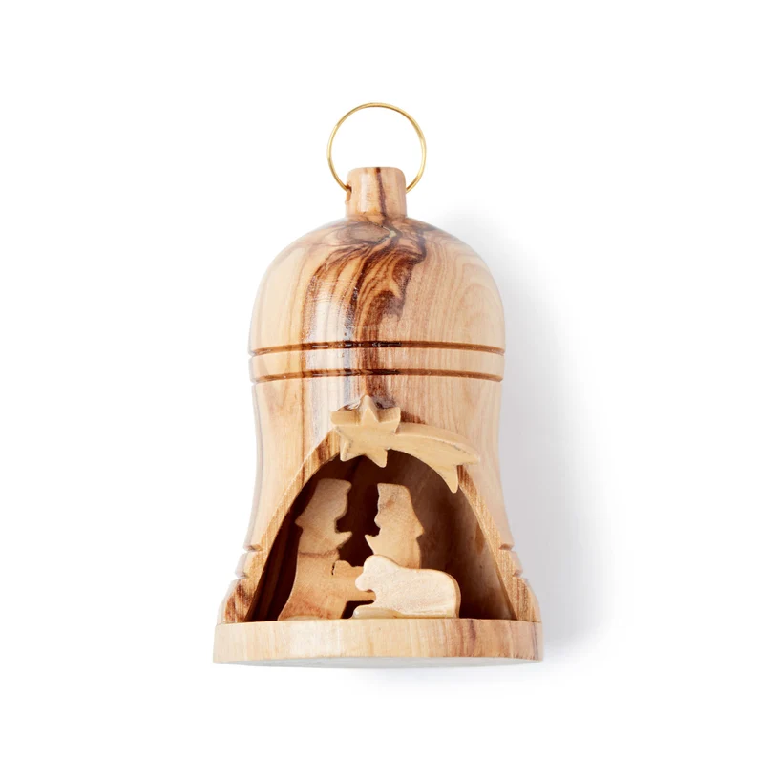
St. Michael’s CE High School
A Church of England Academy
Advent 3
wb: 15.12.25
Day 9
Watch Jingle Bells medley
https://youtu.be/1LkcpS-Surk?si=8NzSPsk-Z1pUYqlT
Look at the image (next slide) first.
How would you describe this?
Is it a piece of religious / sacred art? Or a Christmas decoration? Or maybe even a memento of a visit to the Holy Land (it’s made of olive wood)
How might you decide whether something is sacred or not?
Now play the video
As you listen to the song, can you pick out any words that you know?
Is this a religious or secular song? How do you know this?
Which of the 20 countries have you visited, or would like to visit?

Slide 7
St. Michael’s CE High School
A Church of England Academy
Advent 3
wb: 15.12.25
Day 9

Slide 8
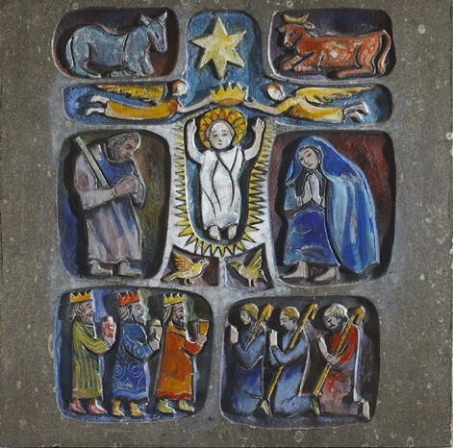
St. Michael’s CE High School
A Church of England Academy
Advent 3
wb: 15.12.25
Day 10
Watch the Kilkenny Nativity story:
https://youtu.be/K-KFKMWZ8sk?si=YR9RlJzNmyi8uzDy
Look at the stone carving (next slide)carefully first.
Does this tell the Nativity story in the same way as other art you have seen?
Do you think there’s a reason why each character is located where they are in the carving? Can you see a Cross in the carving – why do you think that the sculptor included this?
Now watch the video:
The video today was created by residents of Kilkenny, retelling the Nativity story. It beautifully shows diverse parts of the city and its culture as residents read the story from the Gospels of Luke and Matthew.
Which bit of the video did you enjoy most? Why??

Slide 9
St. Michael’s CE High School
A Church of England Academy
Advent 3
wb: 15.12.25
Day 10

